Slide 1
Evolution of Difficult Path Planning Problems
Stephen Webb

Slide 2
Agenda
Path Planning Problems and their uses
Evolving PPPs
Introducing Difficulty to PPP Evolution
Evaluation Method
Results

Slide 3
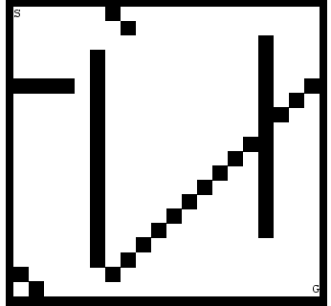
Path Planning Problems (PPP)
Specification of an Environment
2d / 3d
Obstacles
Start Position
Goal Positions(s)
Initial configuration of the robot
Terrain, Elevation, Material…
Objective: Plan and successfully execute a route from the start to the goal position
Notes:
PPP – example of simple PPP on the right
What is a Path Planning Problem?
example of a simple PPP on right
Specification of an environment
E.g. dimensions, location of obstacles, start/goal pos
Maybe more complex with terrain, elevation, multiple goals..
Rules for movement, e.g. forbid diagonal moves in a grid PPP
Likely a simulated environment, but also could be used to lay physical objects out and test a real robot
PPPs might also make specifications about the robot:
Sensor configuration, locomotion, etc.
But this makes them less generically applicable
Objective: Plan a path through the environment from the start to the goal(s)
Ideally an optimal path, but often we’ll settle for a “good enough” path depending on the application
Second part of problem:
successfully execute the plan
Without damaging the robot/environment, breaking the PPP’s rules, etc.

Slide 4
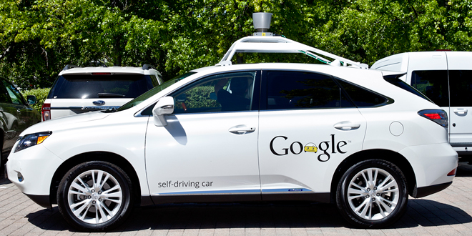
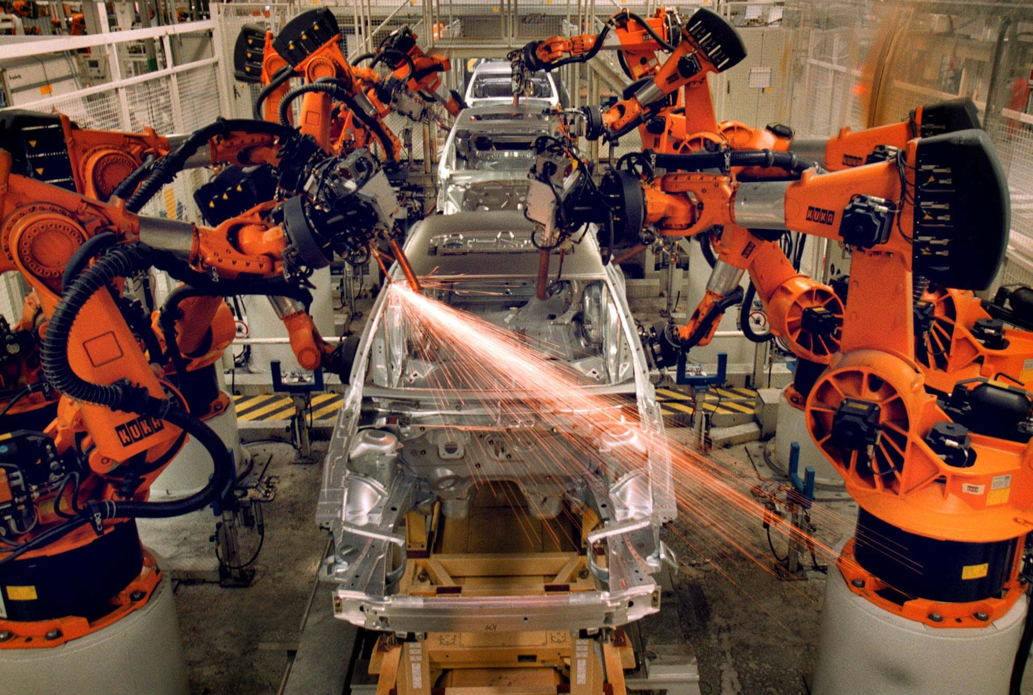
Uses – Testing Autonomous Robotics
Notes:
Uses:
Test the algorithms and capabilities of autonomous robotics
Test in a formal and controlled manner
Why?
Autonomous robotics are increasingly finding applications in unpredictable, dynamic environments such as on the roads
Human oversight may be minimal and the application may well be safety critical
Consider e.g. a driverless car:
Controlled testing – in simulation or a safe environment – to reduce risk to the robot and humans. The car itself is expensive; mistakes on the road might injure or kill.
Formal testing – safety bodies must be satisfied of that the robot is not a danger to others on the roads. PPP others method of formally describing tests carried out

Slide 5
Evolving PPPs
Why?
To provide diversity
To reduce costs
To cover unforeseen circumstances
How?
Genetic Algorithm
D.A. Ashlock “Evolving A Diverse Collection of Robot Path Planning Problems”
Improvements by H. Wei: “Evolving Path-Planning problems to find faults in autonomous mobile robots”
Diversity is assessed by UPGMA, producing trees connecting similar PPPs
This project further extends the approach of the above two
Notes:
Consider, for example, the number of different situations encountered driving on the roads
Handcrafting PPPs for these situations would be costly and time consuming, and wouldn’t cover situations we didn’t foresee
Therefore, we generate PPPs automatically
Reduces costs and times
Produce large sets of test cases
Hopefully, cover unforeseen circumstances
Provide diversity by selecting subset of diverse tests from range of produced PPPs
How
Ashlock proposed a genetic algorithm approach to generation of simple 2D PPPs
Wei implemented and improved upon this approach by improving the fitness function
They use UPGMA to assess PPPs according to a set of taxonomic characters, gathering like PPPs into branches of a tree
This project further extends the approach by introducing a new fitness function as an alternative to the prior

Slide 6
Introducing Difficulty to PPP Evolution
Aim:
Improve the ability of generated PPPs to find faults in test agents
Difficult PPPs
Difficulty is abstract
In this project, I focus on difficulty of exploration
PPPs which are hard to explore obscure and obstruct the optimal route
Method
Multiple approaches are used to measure the exploration difficulty of a PPP in the project
I settled on a fitness function taking into account multiple factors:
Horizontal and Vertical ‘Openness’
Visibility of the map from various locations
(Adjustable) weights on each factor
Etc.
Notes:
This project introduces a new fitness function to Wei’s generator, evaluating and selects for ‘difficulty’ in the PPPs
Fitness function should improve fault finding, ie. Produce PPPs which manifest faults in agents tested on them
Difficulty is abstract – there’s a lot of literature on factors for testing autonomous robots
Inspiration can also be drawn from various tournaments and competitions e.g. RoboCup, DARPA challenges
In this project I focus on difficulty of exploration of an environment – it should however be noted that there are many other facets!
Idea:
PPPs which are hard to explore must in some way obscure and obstruct the optimal route through the PPP
Therefore, the optimal route should be harder to follow, and this should hopefully manifest more faults
I tried several approaches to measuring the difficulty of exploration, evolving the fitness function each development iteration
I settled on a weighted sum taking into account multiple factors which describe the PPP environment in terms of explorative difficulty
Use of this fitness function encourages the generator to select for PPPs which best satisfy these factors
Examples:
Use of all of the obstacle budget
How ‘open’ the environment is – are there areas which are a wide plain, or is the environment claustrophobic?
How many squares of the PPPs are visible from various locations according to a perfect sensor – restricted visibility makes exploration harder.

Slide 7
Evaluation Methodology
Simulation of Test Agents with faults
I produced a simulator with a set of test agents with intentionally faulty path planning algorithms
A ‘good’ PPP will have a low pass rate as it will manifest the agent faults and prevent completion
Methodology
Set of 60 PPPs per fitness function – Wei vs Mine
Each agent runs on each PPP 1000 times
To make nondeterminism (e.g. tie breaks) negligible
Notes:
Evaluation
I produced a simulator to evaluate the PPPs
Set of agents with intentional faults in path planning
PPP pass rate shows how good it was at discovering faults
Low pass rate = high fault discovery
Method
Generated 60 PPPs by each fitness function with 10,000 mating events
Each test agent runs on each PPP in the set 1000 times
minimise effect of non determinism in their algorithm
Diversity – existing UPGMA implementation used to produce tree graphs describing PPP set
This was investigated by comparison to see if PPPs with similar layouts were more correctly grouped together

Slide 8
Results
Fault Finding
Difficult PPPs did not improve upon the ability of the existing fitness function to find faults in test agents.
In the case of some test agents used by this project, statistically less faults were discovered.
This is shown by significantly higher pass rates
Notes:
Fault Finding
Evolving PPPs for difficulty did not improve the ability to manifest test agent faults.
Avg. pass rate over ‘difficult’ PPPs higher than Wei PPPs as shown on graph
The faults of 3 agents were found significantly less often
It is plausible that the simplicity of the PPPs generated – 2d grids, restricted number and type of obstacles – does not reward a more complex solution

Slide 9
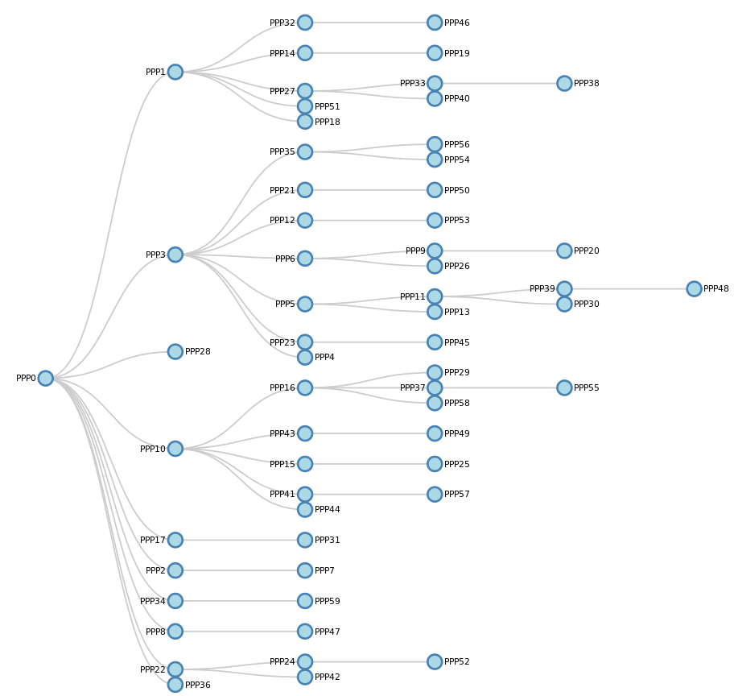
Results
Diversity
The approach to measurement of difficulty produced many factors describing the environment of a PPP.
Incorporating these descriptions as taxonomic characters improved the classification of PPPs
Notes:
Diversity
As discussed on the previous slide, the evaluation of difficulty produced many descriptions of the PPP environment
These were incorporated into the taxonomic character set.
I produced trees for the new and old character set over a single set of 60 PPPs
By comparison between the two, the new set was better at classifying PPPs with similar layouts in the environment

